Slide 1




SALES DATA ANALYSIS
ADVANCED EXCEL PROJECT
Presented by,
Pavithra.M
09/09/2025
DADS JULY COHORT A

Slide 2
PROJECT OVERVIEW
TO ANALYZE SALES DATA TO IDENTIFY TRENDS, UNDERSTAND SALES PERFORMANCE,
AND PROVIDE ACTIONABLE BUSINESS INSIGHTS.
GOALS
TO ANALYZE SALES TRENDS OVER TIME.
TO IDENTIFY HIGH-PERFORMING PRODUCTS AND SALES CHANNELS.
TO DETERMINE THE IMPACT OF RETURNS AND DISCOUNTS.
TO CREATE A DYNAMIC DASHBOARD WITH KEY METRICS.

Slide 3
DATA OVERVIEW
GIVEN SUPERSTORES SALES DATASET WITH ROWS 9995 HAS COLUMNS AS ROW ID, ORDER ID ,ETC..
DATA CLEANING PROCESS
FORMATTED COLUMNS AS PER DATE AND CURRENCY IN SALES, DISCOUNT AND PROFITS.
REMOVED DUPLICATES AND BLANK ENTRIES IN THE DATASET.
USED DATA VALIDATION TO ENSURE NO NEGATIVE VALUES IN SALES AND DISCOUNT COLUMNS.
EMPLOY IF TO CHECK THE ERRONEOUS ENTRIES.

Slide 4
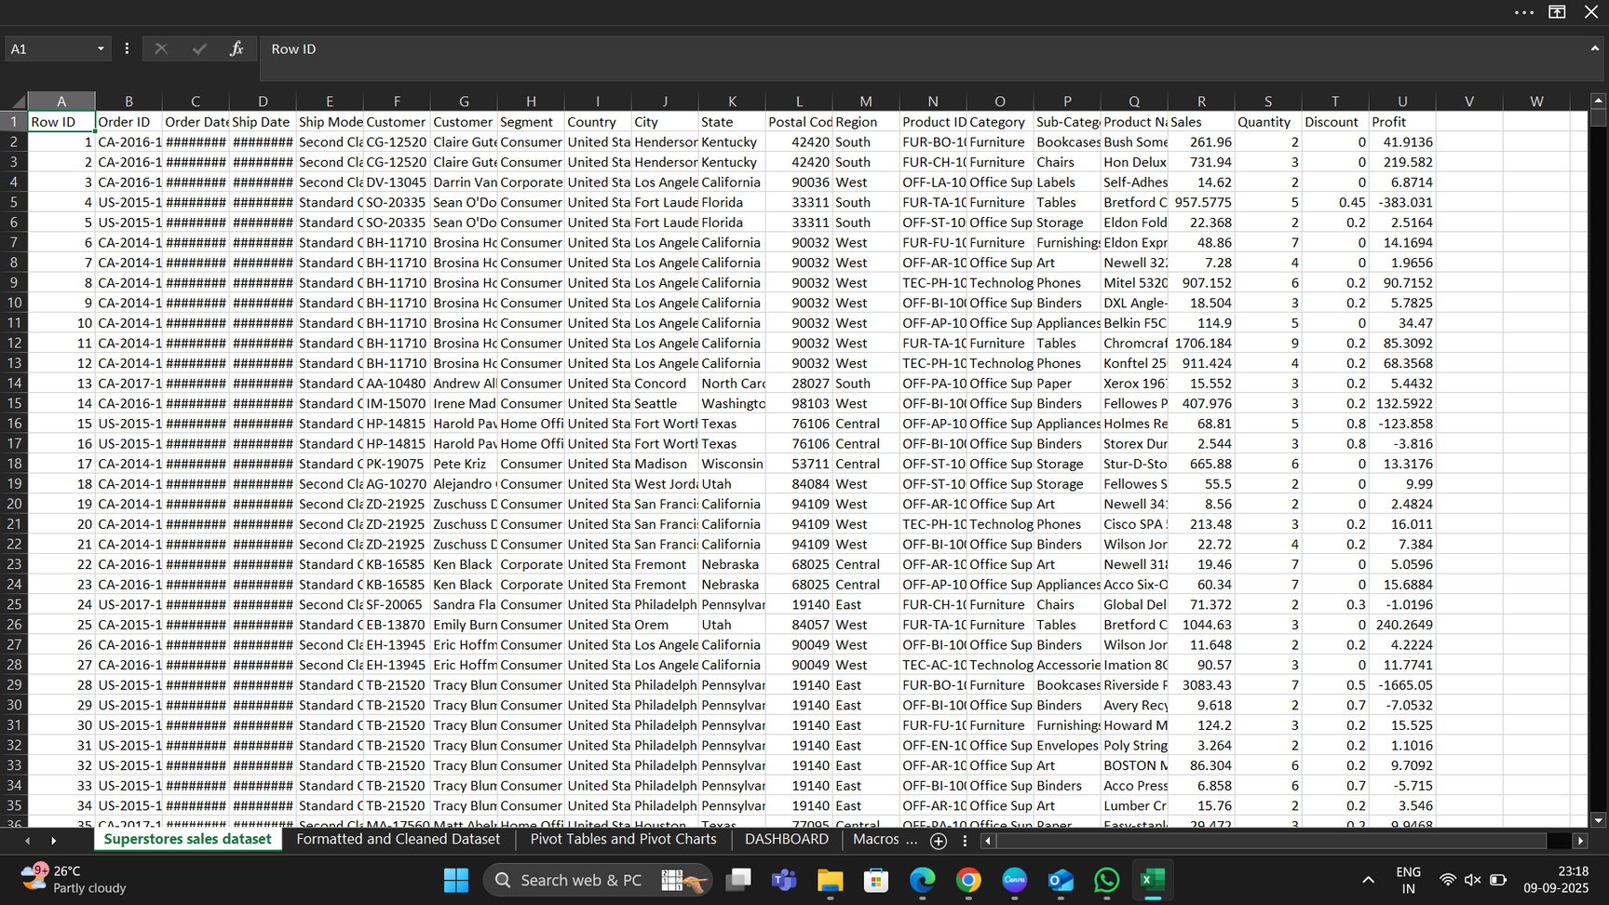
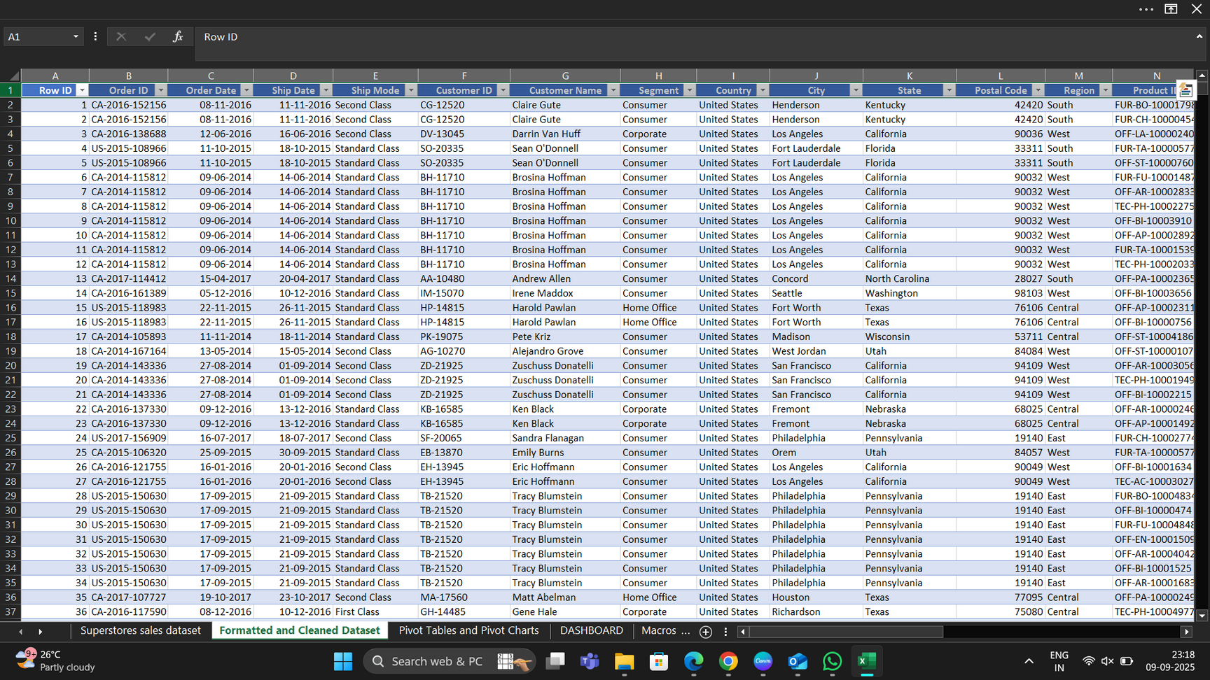
DATASET BEFORE AND AFTER CLEANING

Slide 5
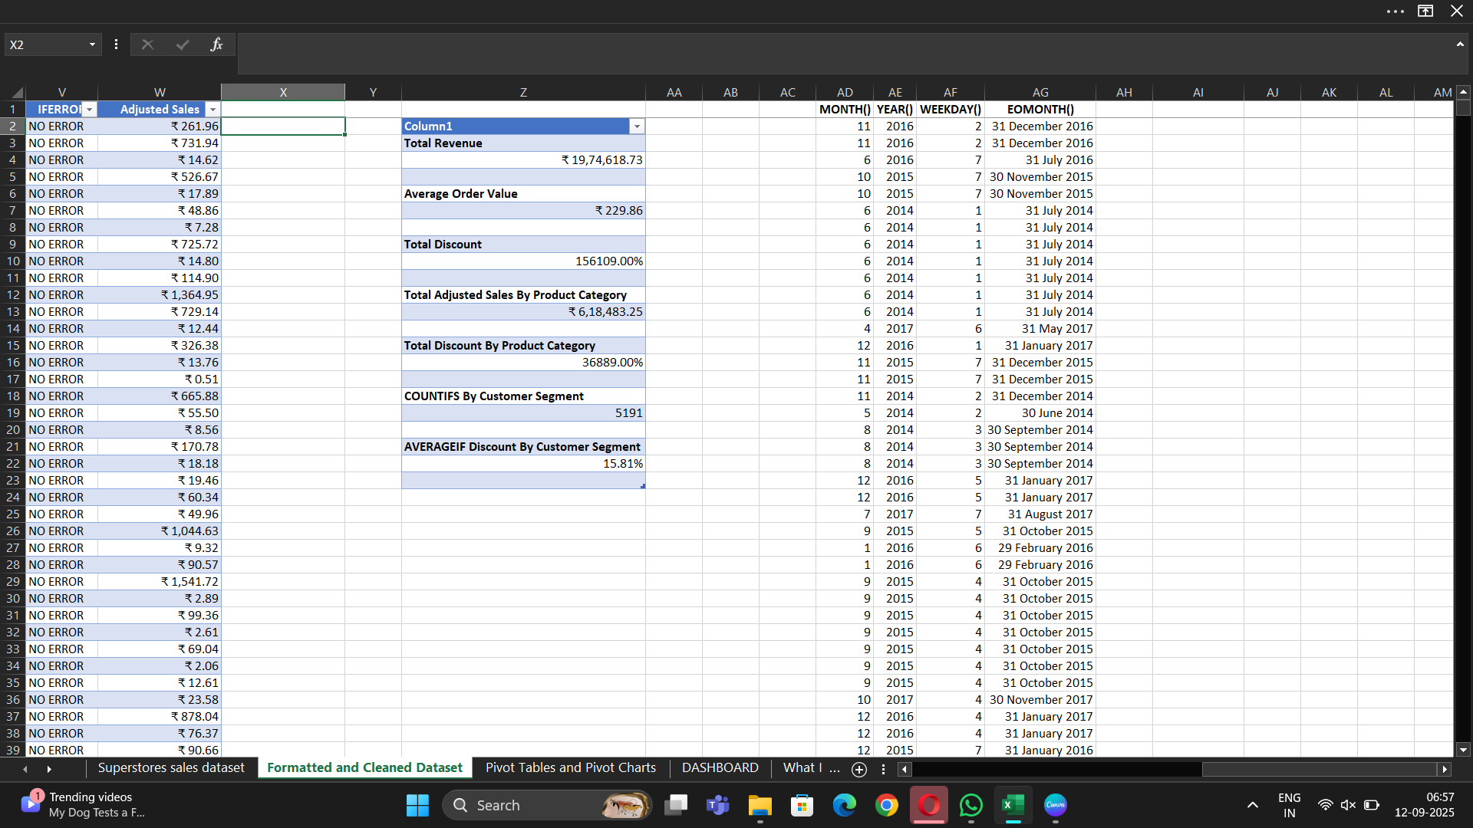
KEY METRICS AND CALCULATION
TOTAL REVENUE = SUM(TOTAL ADJUSTED VALUE)
AVERAGE ORDER VALUE = AVERAGE(TOTAL SALES)
TOTAL DISCOUNT = SUM(TOTAL DISCOUNT)
ADJUSTED SALES BY PRODUCT = SUMIFS(TOTAL ADJUSTED SALES,TOTAL CATEGORY,”FURNITURE”)

Slide 6
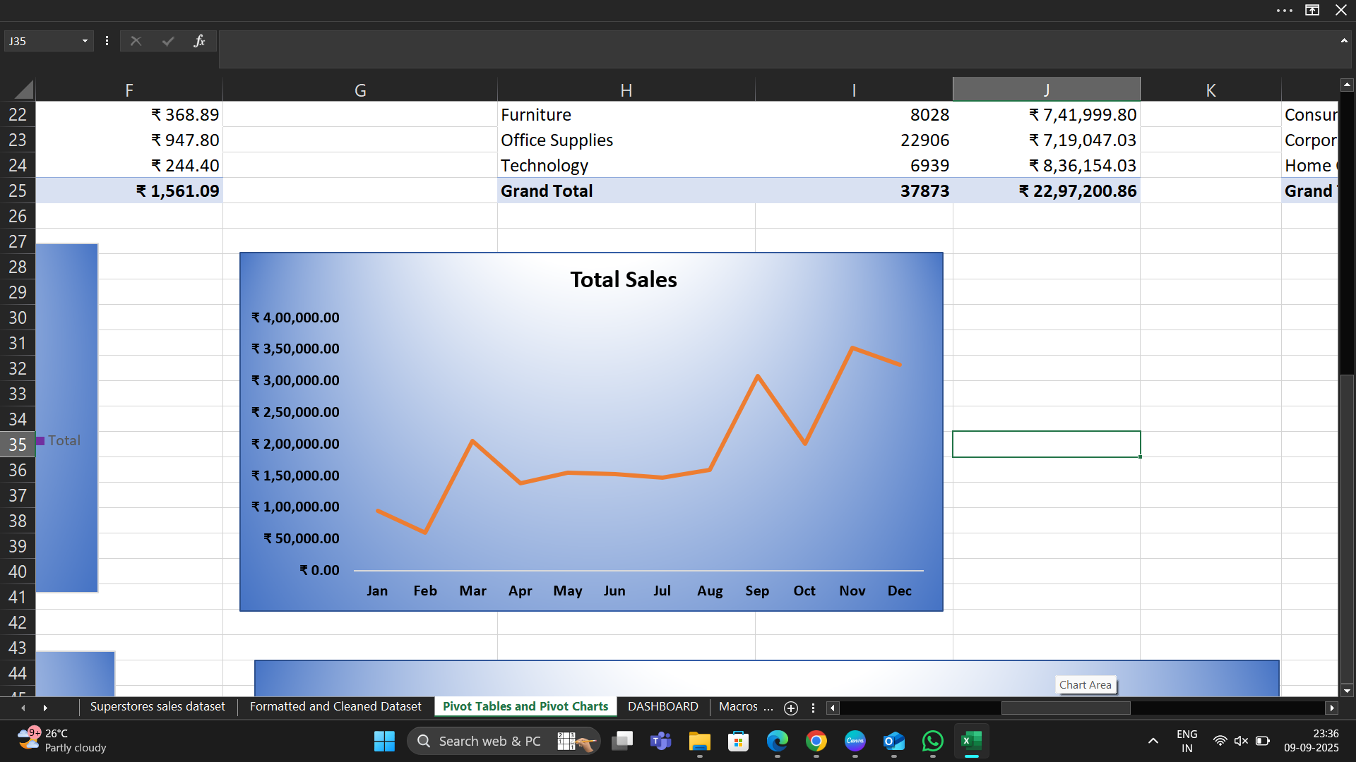
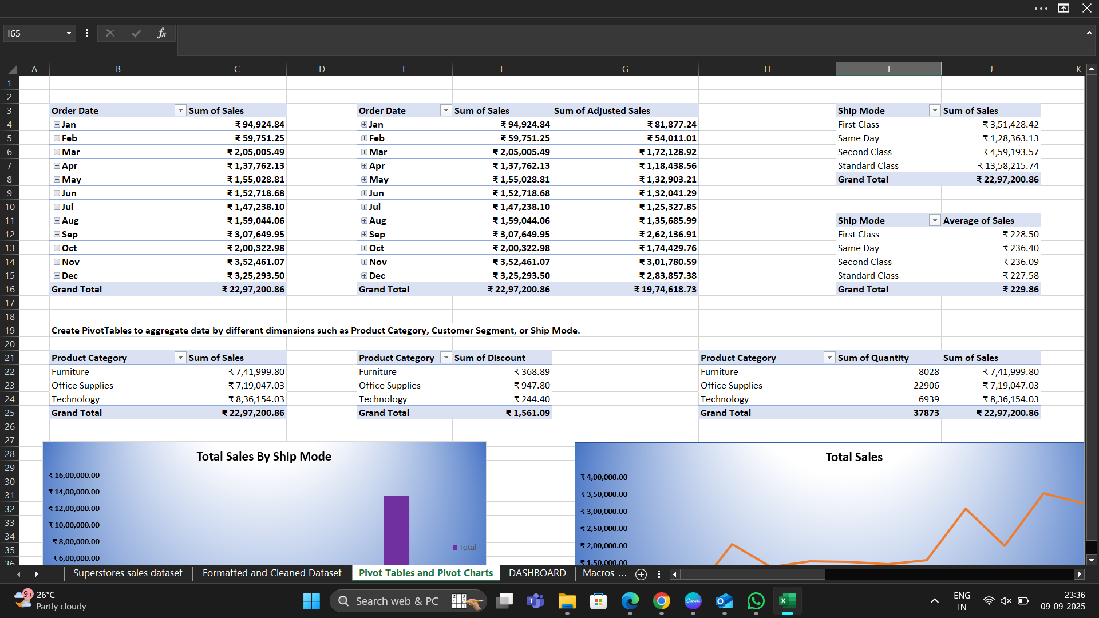
PIVOT TABLES AND PIVOT CHARTS
CREATED PIVOT TABLES BASED ON SALES BY MONTHLY, YEARLY ,ETC.
Created Pivot Chart using Pivot table to ANALYZE the SALES trend Over Time

Slide 7
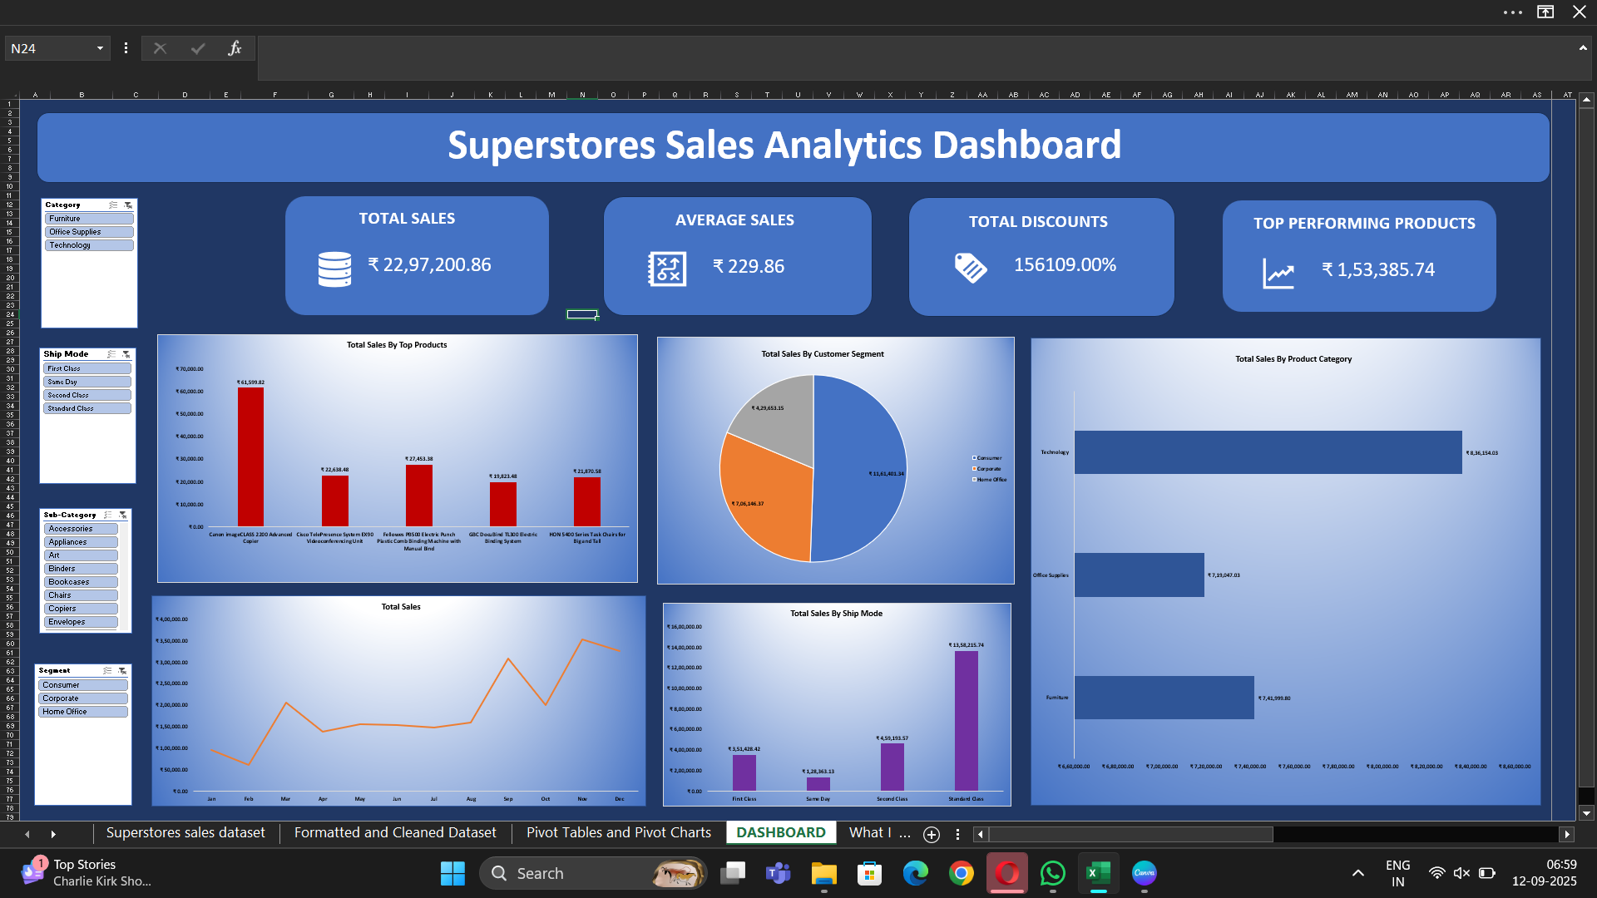
DASHBOARD OVERVIEW

Slide 8
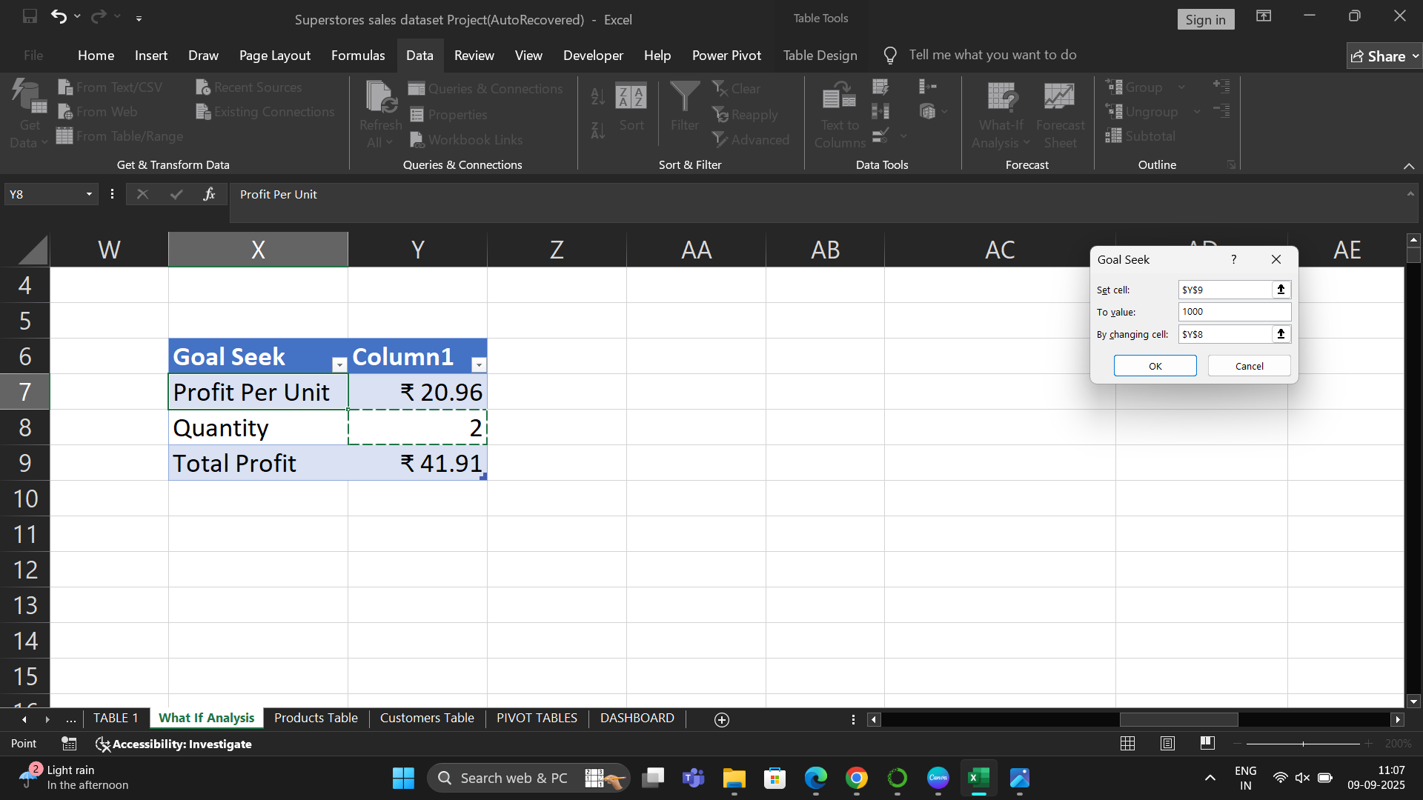
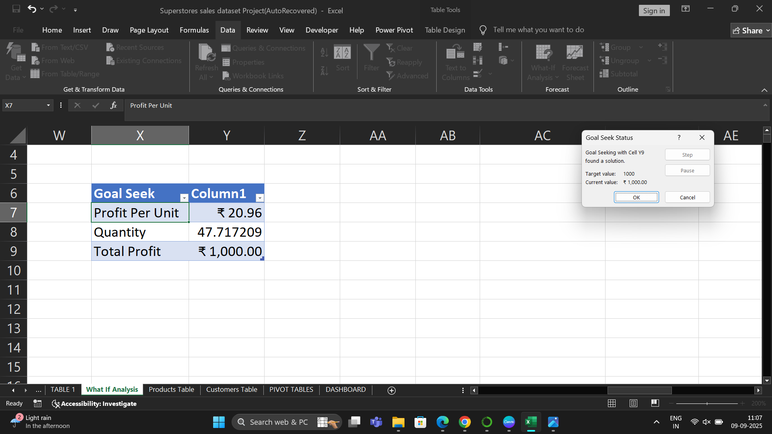
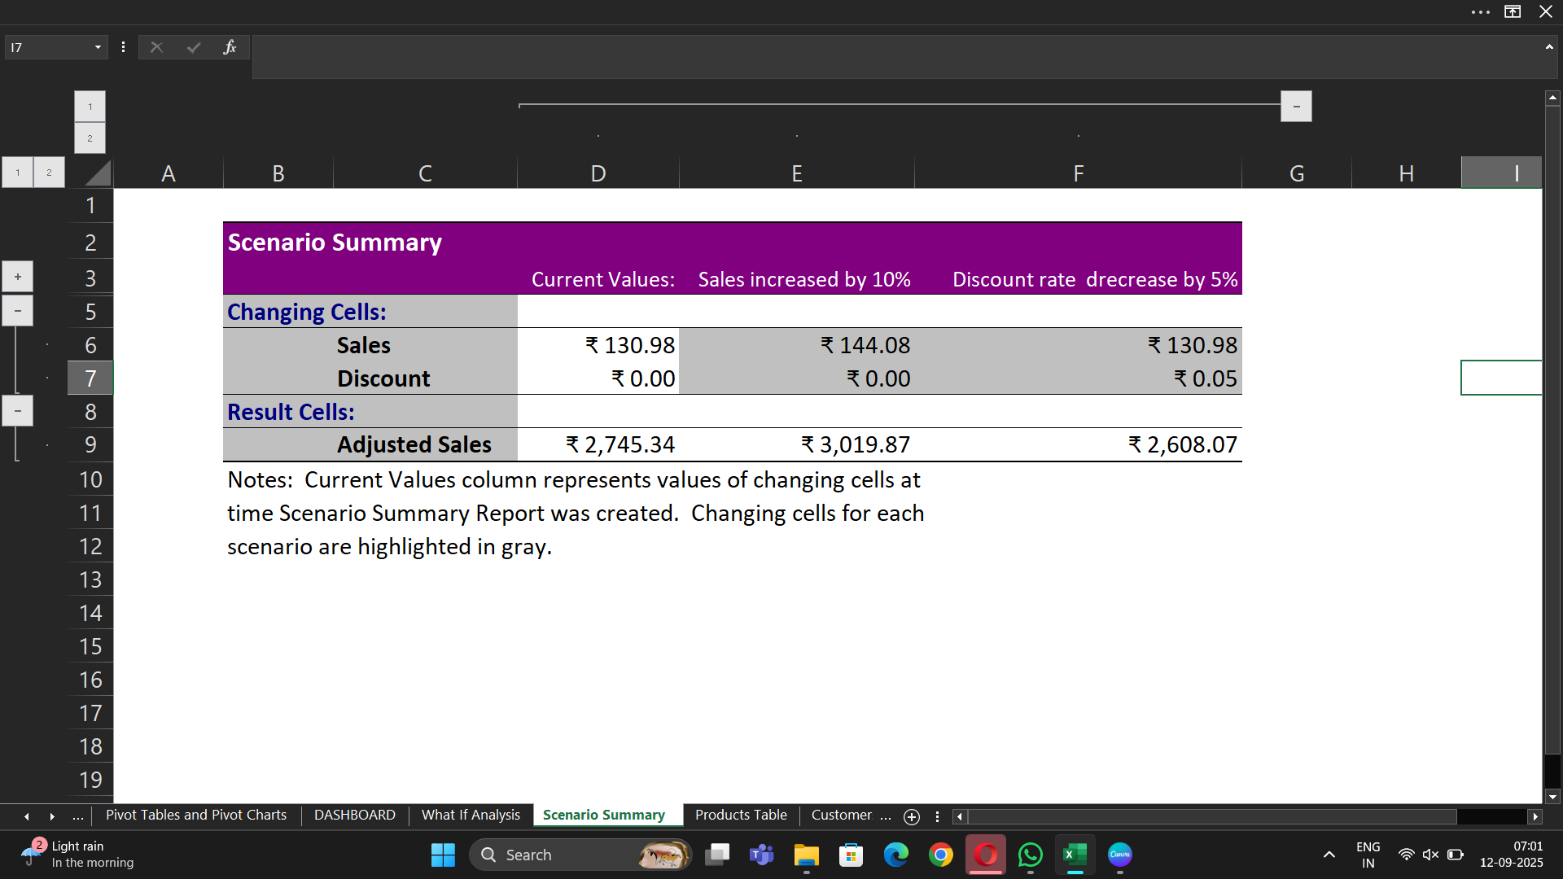
WHAT IF ANALYSIS AND GOAL SEEK

Slide 9
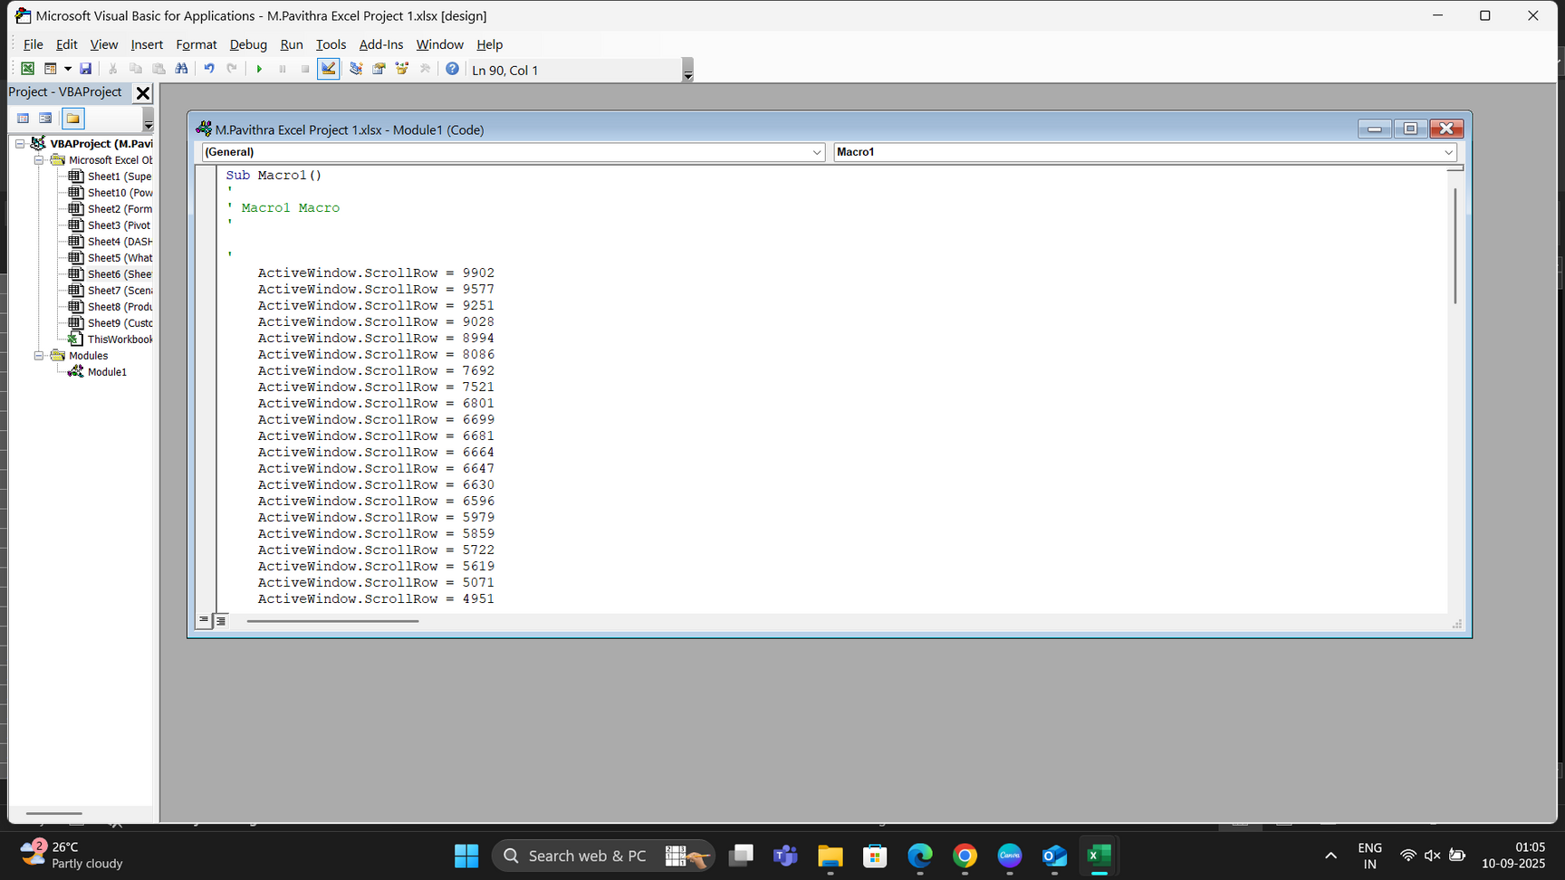
MACROS
USED MACROS TO RECORD FORMATTING THE WORKSHEET.
RUN MACROS TO AUTOMATE TASKS

Slide 10
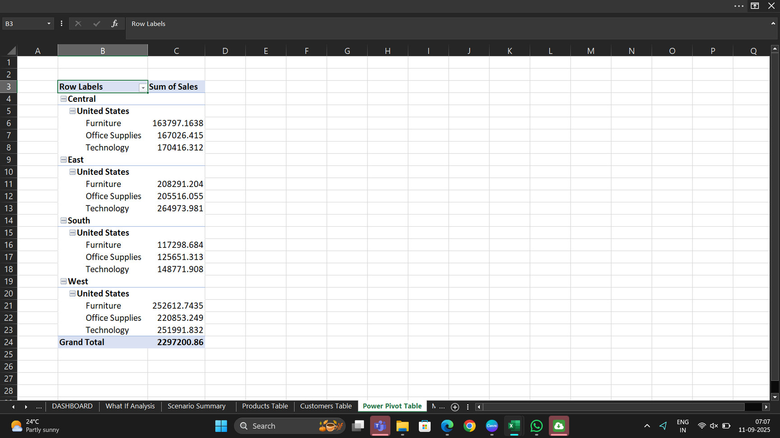
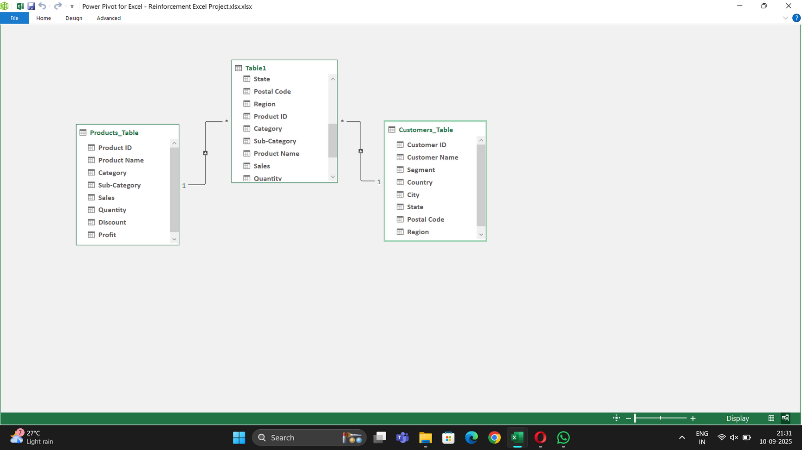
POWER PIVOT
ADDED DATA MODELS USING POWER PIVOT.
CALCULATED PROFIT MARGIN (PROFIT / SALES) IN POWER PIVOT.
CREATED POWER PIVOT BASED PIVOT TABLE USING DATA MODELS.
DIAGRAM VIEW OF DATA MODEL
POWER PIVOT BASED PIVOT TABLE

Slide 11
INSIGHTS
BEST-PERFORMING PRODUCT CATEGORY IS TECHNOLOGY AROUND RS.8,36,154.03 .
STANDARD CLASS IN SHIP MODE GOT A GOOD AMOUNT OF SALES COMPARING TO OTHERS IN SHIP MODE.
THE CONSUMER IN SEGMENT HAS INCREASED FROM RS.2,66,096 TO RS.3,31,904 BETWEEN THE YEARS 2014-2017.
COMPARING TO OTHERS IN SHIP MODE , TOTAL SALES ON SAME ON DAY RESULTS VERY LOW.
DISCOUNTS ARE HIGH (13-16%) AND THEY AFFECT THE PROFIT,ESPECIALLY FOR FURNITURE

Slide 12
RECOMMENDATIONS
IMPROVE ON TOTAL SALES ON SAME DAY TO INCREASE THE TOTAL SALES OF SHIP MODE.
NEED TO FOCUS ON OFFICE SUPPLIES IN PRODUCT CATEGORY TO INCREASE TOTAL SALES BY CATEGORY-WISE.
NEED MORE FOCUS ON HOME OFFICE ON CUSTOMER SEGMENT SINCE IT HAS VERY LOW SALES COMPARATIVELY TO CONSUMER AND CORPORATE.
PLAN FOR MORE GROWTH SINCE THE SALES ARE INCREASING , KEEP ENOUGH STOCK AND MANAGE DELIVERY WELL.

Slide 13
CONCLUSION
THIS PROJECT IS SUCCESSFULLY FORMATTED AND CLEANED FOR BETTER ANALYSIS USING ADVANCED EXCEL TECHNIQUES.
WITH PIVOT TABLES AND PIVOT CHARTS WE CAN SUMMARIZE THE DATASET FOR INTERPRETATION.
THE INTERACTIVE DASHBOARD WITH KPI’S, GIVES BEST WAY TO VISUALISATION AND INSIGHTS.
WHAT IF ANALYSIS SUPPORTS THE DECISION-MAKING BY PREDICTING OUTCOMES IN EXCEL.
AUTOMATE TASKS USING MACROS REDUCES MANUAL EFFORTS AND INCREASES EFFICIENCY.
OVERALL , THIS PROJECT GIVES THE BEST INSIGHTS FOR INTERPRETATION AND VISUALISATION.

Slide 14

THANK YOU

